Slide 1
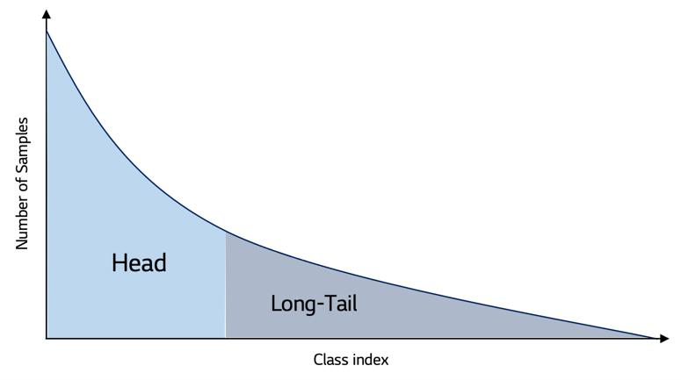
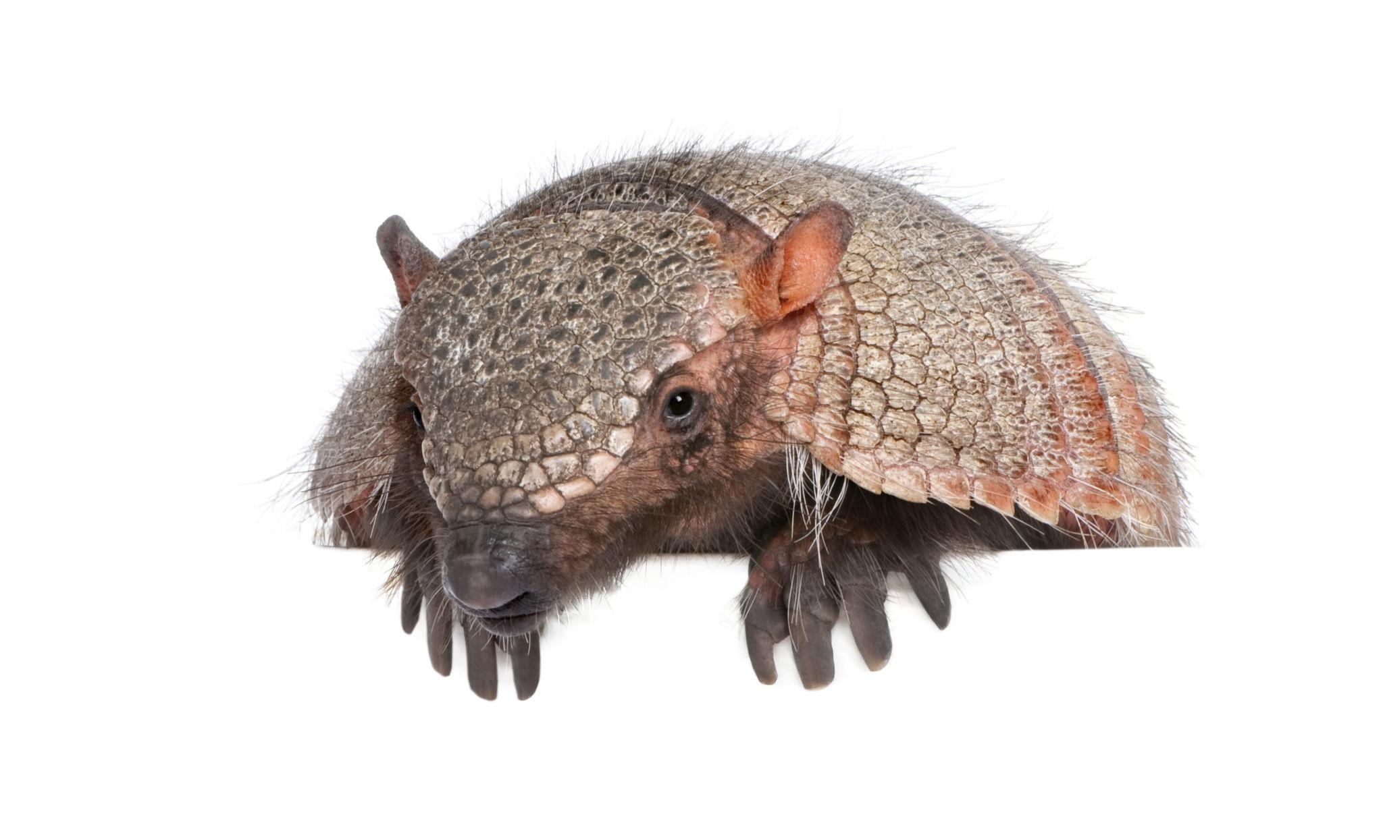


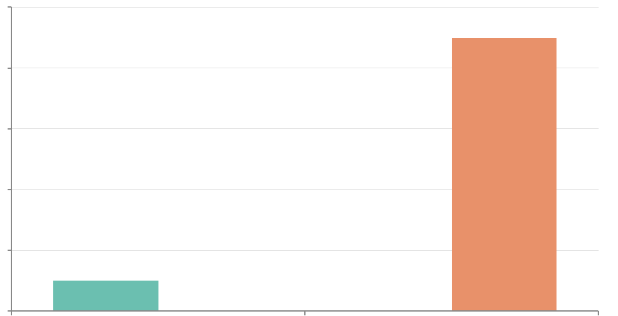

1
2
3
4
5
PROBLEM
MULTI-SOURCE SEMANTIC EVIDENCE
SEMANTIC ENCODING
MUTI-SOURCE SEMANTIC FUSION
Semantic Recognition & Evaluation
Target Object Class e.g., ‘Armadillo’
Vision Language Model
(eg., CLIP)
Fusion Strategies
Open-Vocabulary Semantic Recognition
⟐
Semantic Evidence Fusion
Long-tail Distribution
🚌
🐕
🚲
Image Encoder
Text Encoder
🚗
Softmax-Weighted Fusion
armadillo
Promt 1
eee
Frequency-Aware Semantic Reweighting
Limitations of current Open-Vocabulary Recognition
Text embeddings (One per Prompt)
Uncertainty-Aware Fusion
nine-banded armadillo
Promt 2
Σ
e1
e2
armored mammal
Promt 3
Fusion Output
Lack of principled Fusion & Uncertainty handling
e3
(Fused Semantic Representation)
Head
Frequency
Tail
cingulate animal
Promt 4
en
ff
Final Prediction
Class Distribution Imbalance Factor: 0.10)
Improved semantic recognition of rare and unseen categories
1000
800
dasypod
Similarity Computation
Frequency
600
400
Image embedding(V)
(Vision–Semantic Matching)
200
🐘
🐦
🪑
0
0
Class
1
s = sim(v, f) (e.g., cosine similarity)
Poor performance on unseen object
armadillo species
Prompt N
🎯
EXPECTED IMPACT
📈
Better recognition of rare & unseen categories
🛡
Robust to prompt variations & uncertainty
🗄
Structured semantic evidence aggregation
💡
Advances in Information Fusion & Open-Vocabulary Recognition

Slide 2
1
2
3
4
5
PROBLEM
METHOD
FUSION CORE
RESULTS
IMPACT
Semantic Prompt Generation
★ Semantic Fusion Strategies
Key Quantitative Results
Research Contributions
Long-Tail Distribution Problem
WordNet
LLM Paraphrase
AP_seen
Mean Fusion
Weighted Fusion achieves highest GZSD HM
Synonyms · Hyponyms · Hypernyms
GPT diverse descriptions
Arithmetic mean of all prompt similarity scores
AP_unseen: 67.5%
RQ1
RQ2
Max Fusion
Prompt fusion as evidence +6.1 AP_rare
Weighted fusion provides the most balanced GZSD performance
Prompt Pool (1-10 per class)
Highest similarity score across prompt set
AP_unseen
armadillo
nine-banded
armored mammal
AP_unseen: 63.1%
63.5% → 67.7% (+4.2 pts)
Head classes: 5,000+ imgs
dasypod
cingulate
Seen vs unseen category imbalance ⚠
CLIP ViT-L/14 Encoding
Weighted Fusion
RQ3
RQ4
Softmax-based weighting
GZSD HM
Entropy-aware fusion provides semantic uncertainty estimation
Image Encoder 768-d
Text Encoder 768-d
AP_unseen: 67.7%
58.4% → 61.2% (+2.8 pts)
Prompt diversity improves semantic robustness
LVIS v1.0 Dataset
1,203
337
164K
Categories
Long-tail categories
Images
Cosine Similarity → Score Matrix (N × M)
Semantic Evidence Fusion
Stable robustness across prompt perturbations
RQ5
RQ6
COCO-ZSD Benchmark
Aggregates complementary semantic prompt evidence
Frequency-aware weighting (\alpha = 0.4)
Stable robustness across prompt perturbations
48 Seen
17 Unseen ★
Preprocessing Pipeline:
vs 0.76 baseline
Entropy-guided uncertainty estimation
Performance varies with prompt diversity and count
Limitations of Existing OVD
Resize 640×640 · Normalise
Frequency-aware semantic weighting
63.5%
✕ Single prompt — no diversity
Scalable · No extra training data Info Fusion + CV community impact
Parse annotated object regions
AP unseen vs Prompt Count
✕ No uncertainty modelling
Entropy-aware fusion provides diagnostic calibration signals
✕ Unseen categories remain challenging under generalized zero-shot recognition
LVIS + COCO-ZSD semantic evaluation setup
Improved semantic uncertainty estimation

Slide 3















1
2
3
4
5
6
Dataset
Acquisition
Data
Preprocessing
Semantic Prompt
Generation
Frequency-aware semantic weighting
Experimental
Evaluation
Results
& Impact
LVIS v1.0
↑ AP_unseen: 63.5 → 67.7 (+4.2 pts)
1,203 categories · long-tail
Image Resize
& Normalise
Semantic Recognition Metrics
WordNet Synonyms
Rare & unseen categories
vs. single-prompt baseline
COCO-ZSD
Image Stream
Text Stream
ImageNet stats normalisation
CLIP-ViT encoder
CLIP text encoder
AP_seen • AP_unseen • GZSD HM
Generalized zero-shot recognition evaluation
Hyponyms · hypernyms
hierarchical relations
Visual feature
embeddings
Per-prompt
text embeddings
Ours (fusion)
Annotation Parsing
Annotated object regions
Cosine similarity
Ablation Studies
Baseline
LLM Paraphrasing
Long-tail distribution
Annotated object regions · class labels
Fusion strategy compare
Prompt count 1–10 effect
Prior-aware fusion impact
GZSD HM comparison
GPT-based diverse
descriptions
★ Semantic Fusion Strategies
10%
10%
Robustness (RQ6)
Fusion weight heatmap
Mean
Max
Softmax
Weighted
Evaluation protocol setup
cat
mouser
Frequency-aEntropy-aware uncertainty estimation
ware semantic weighting
Noisy/adversarial prompts
Perturbation stability
Frequency-Aware Semantic Weighting
tabby
Kitty
Redundancy-complementarity analysis (RQ3 · RQ4)
Semantic recognition scores
Head
Common
Rare
feline
domestic
cat
Class frequency distribution
Region-Based Semantic Fusion Framework
1–10 prompts per category
Region-based semantic similarity scoring
Semantic similarity computed over annotated object crops
armadillo 0.94
Findings contribute to
Info Fusion + CV communities
mouser 0.87
Complementary semantic prompt sources
chalice 0.71

Slide 4
1
4
Preprocessing
5
Prompt Generation
7
Semantic Fusion + Similarity Aggregation
LVIS v1.0 Dataset
2
COCO-ZSD Dataset
🖼️ Resize & Normalise
🌳 WordNet Synonyms
Mean
48
17
ImageNet mean/std
Hyponyms · Hypernyms
164,062
1,912,652
1,203
Unseen classes
Max
Images
Instances
Categories
Seen classes
🤖 LLM Paraphrase
Long-Tail Class Distribution:
Seen vs Unseen split:
Diverse descriptions
Softmax
48 Seen
17 Unseen
405
461
🏷️ Parse Annotations
★ Weighting
337
Zero-Shot:
Prompt Pool (per class)
Bounding boxes + class IDs
cup
mug
chalice
Train on 48
Test on 17 unseen
Semantic Similarity Aggregation
goblet
vessel
beaker
Frequent
>100 imgs
Common
11–100
Rare
<11 imgs
1–10 prompts per category
Region-Based Semantic Similarity Scores
8
3
✂️ Split Data
6
CLIP Encoding
Evaluation
Example Data Record — Example Region Annotation Sample
Dataset Partitioning LVIS + COCO-ZSD protocol
ID
Title
Context
Label
Cup, Mug
👁 Image Encoder (ViT)
AP_seen
56be8554...
Beyoncé
Image of object with category label + bounding box annotation. Dense multi-category scene.
Visual feature embeddings
Bounding Box Annotation:
Prompt Robustness
cup
mug
[x1,y1,x2,y2]
class_id: 274
🔒 Unseen Subset
📝 Text Encoder (CLIP)
Long-Tail Challenge
Per-prompt text embeddings
AP_unseen (ZSD)
Common class:
5,000+ images
Rare class:
<10 images
17 classes held out (zero-shot)
Category: rare (<11 training images)
Cosine Similarity → Scores
GZSD Harmonic Mean

Slide 5
1
2
3
4
5
6
7
8
Semantic Fusion Module
Semantic category scoring
Recognized rare/unseen categories Frequency-adjusted semantic predictions
Pretrained CLIP Visual Encoder
Annotated object crops
Prompt Generator
Cosine Similarity
8
Output
Input Image
CLIP
Text
512-d
Region embeddings
Object-region feature aggregation
N×512
N×M
Rare wt
CLIP embedding vectors
Semantic prompt refinement Prompt diversification
Cosine
Similarity
v · t
|v||t|
N×M
matrix
Class-frequency weighting
5
1,203 LVIS semantic categories Similarity-based scoring Frequency-aware semantic weighting
Prior
Class-frequency prior weighting
Input Image 640×640 ×3 RGB
LLM Paraphrase |
cup, mug, goblet...
Conflict
Entropy-based
Evidence
1–10 prompts/class
WordNet
Synonyms /
Hyponyms
Strategies
Mean / Max / Weighted / Softmax-weighted
Pretrained CLIP visual encoder
Object-region visual embeddings
Annotated object crops Object-region visual features
Prompt Generator | 1–10 prompts/class · WordNet+LLM · 512-d each
Cosine Similarity | Vision-Semantic matching · N×M score matrix
Semantic Fusion Module Frequency-aware semantic fusion
Semantic category scoring Region-category similarity association Frequency-aware semantic weighting
Region-based semantic recognition outputs Rare/unseen category recognition

Slide 6
SEEN CLASS PATHWAY (48 classes — training + testing)
1
2
3
4
5
6
7
Input Images (Seen)
Annotated object-region extraction
Seen Class Embeds
Seen Recognition
COCO
Images
48 seen
Cosine Similarity
★ Semantic Fusion
Seen Semantic Recognition
Annotated object regionsCLIP region embeddings
48 CLIP text vectors
Pre-computed cache
WordNet+LLM prompts
48 × 512-d matrix
1-10 prompts/class
N_regions × 48 Seen scores
cosine(v,t)
Score: 0-1
Evidence pool
★Softmax-weighted fusion
48-class semantic similarity scoring
8
GZSD Evaluation
Harmonic Mean:
2 · AP_seen · AP_unseen
─────────────────
AP_seen + AP_unseen
AP_seen → seen test
AP_unseen → unseen test
Pretrained CLIP-ViT Encoder
HM ↑ +4.3 pts
AP_unseen ★
+4.7 pts
UNSEEN CLASS PATHWAY (17 classes — ZERO-SHOT only, no training data!)
1
2
3
4
5
6
7
AP_seen ↑ +4.1 pts
Test
Images
17
unseen
Annotated object-region extraction
Unseen Class Prompts
Zero-Shot Sim
Class-frequency Semantic Fusion
Unseen Recognition
Input Images (Unseen)
Unseen Zero-Shot Recognition
GZSD Evaluation & Results
Annotated object regionsCLIP region embeddings
17 CLIP text vectors
NO training data!
WordNet+LLM prompts
17 × 512-d matrix
Zero-shot transfer
M_regions × 17
Unseen scores
Text-only!
ZERO-SHOT
No training
Frequency-aware semantic weighting
COCO class priors
Semantic Semantic prompt signals
Reduce semantic ambiguity
Frequency-adjusted semantic scores
Pretrained CLIP-ViT Encoder

